Slide 1
ENSURE GREATER ENCRYPTION IN ELECTRONIC MEDICAL RECORDS
BY USING SCRAMBLED ALPHA-NUMERIC RANDOMIZATION
AND THE RSA METHOD
Bethi Naga Bhargavi (122014007, Information and Communication Technology)
Batchu Sumanth (122015012, Information Technology)
Malepati Nagendra Deepak (122015058, Information Technology)
4th – Year
Major Project - AY2022
Final Review Presentation
Project Guide – Lavanya M (SOC)

Slide 2
Introduction
Various company sectors want to make sure that their data is safe and secure. The notion of cryptography is a key answer to the problem of data insecurity
Various cryptographic methods have been developed throughout the years in order to assure the highest level of message security while transmission via unsecure channels
Both asymmetric and symmetric cryptography techniques are safe. However, for the purposes of this work, asymmetric cryptography will be emphasized. As a result, this study focuses on well-known asymmetric method such as the RSA Cryptographic algorithm

Slide 3
Problem Statement
A secure method of data encryption and decryption is proposed in this study by using the notion of scrambled alpha-numeric randomization to offer a clear comprehension of the RSA algorithm's operating mechanism during the encryption and decryption process.
In the case of each new message receiver, the scrambled alpha-numeric randomization mechanism assigns a unique numerical and/or lettering sequence to each letter of the alphabet.
The cryptographic message syntax is also implemented, along with the usage of American standard code for information exchange (ASCII) encoding. The main benefit will be that data security and authentication will be improved.

Slide 4
Literature Survey
References | Indexing at/year | Methodology
Sharma K, Agrawal A, Pandey D, Khan R, Dinkar S. “ RSA based encryption approach for preserving confidentiality of big data.” | 2019 | The authors proposed a novel patient-centric system model for access control to SHIs stored in semi-honest servers.
Meenal J, Manoj Singh. “Identity based secure RSA encryption system from advances in intelligent systems and computing.” | 2017 | Represents an RSA enabled identity based encryption (IBE) scheme that overcomes the security problems of RSA and has linear computations involved which makes key management and revocation relatively easy.
Easttom C. “ The RSA algorithm explored.” | 2017 | The RSA algorithm was explored by giving more clarification to the concept of encryption algorithm.
Major Project – Final Review

Slide 5
Literature Survey
References | Indexing at/year | Methodology
Meneses F, Fuertes W, Sancho J, Salvador S, Flores D, Aules H, et al. “RSA encryption algorithm optimization to improve performance and security level of network messages.” | 2016 | Proposed to optimize the traditional RSA cryptographic algorithm by increasing the use of computational resources (Client and Server).
Nikita S, Dharmendra M. “An improved RSA cryptographic system.” | 2014 | Proposed scheme for RSA cryptosystem where instead of the regular two prime numbers used for key derivation, three are used in its place. They also explored the issue of speed and looked to improve speed.
Amare AA, Vuda S. “A modified RSA encryption technique based on multiple public keys.” | 2013 | Proposed an improvement on the regular RSA algorithm such that two public keys are generated during the key generation process and these two public keys are used simultaneously instead of one as against the regular RSA cryptographic algorithm.
Major Project – Final Review

Slide 6
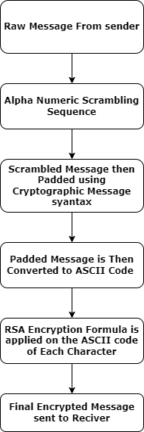
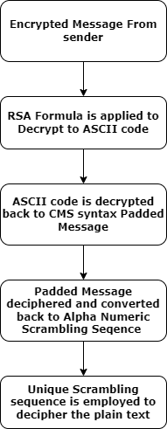
Methodology (Base Paper)
Encryption Algorithm Decryption Algorithm

Slide 7
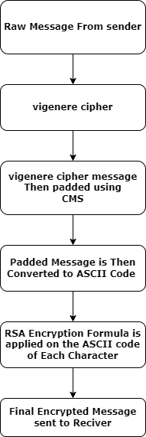
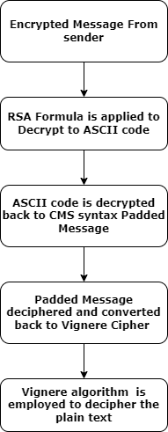
Methodology (Proposed Technique)
Encryption Algorithm Decryption Algorithm

Slide 8
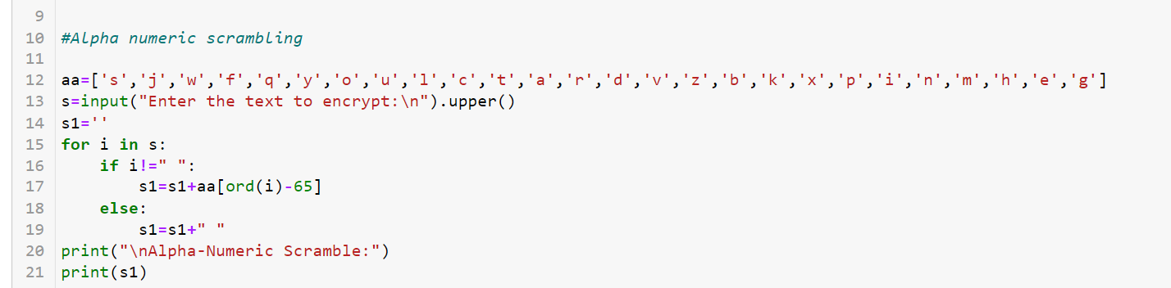
Work Carried Out
Alpha Numeric Scrambling

Slide 9
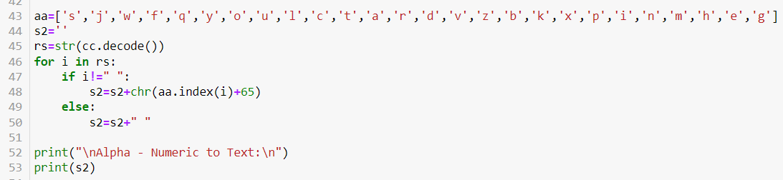
Work Carried Out
Reverse Alpha Numeric Scrambling

Slide 10
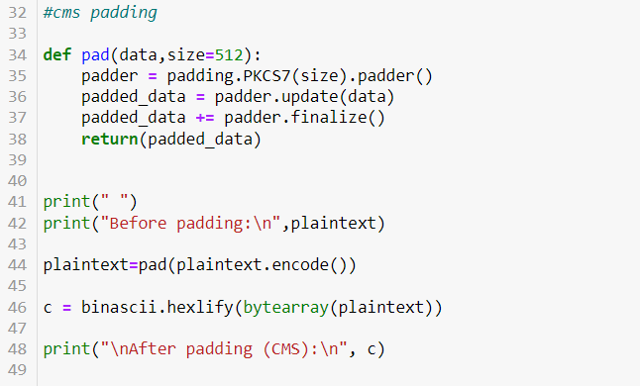
Work Carried Out
CMS padding

Slide 11
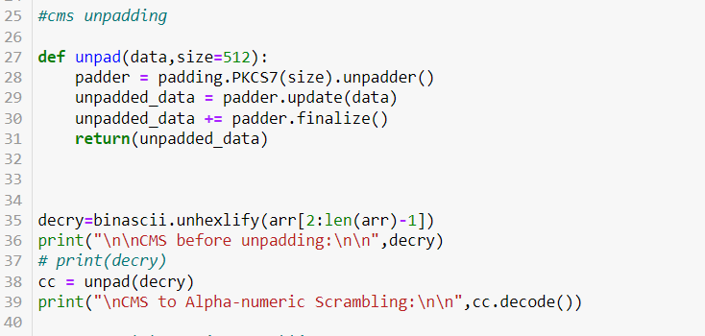
Work Carried Out
CMS unpadding

Slide 12
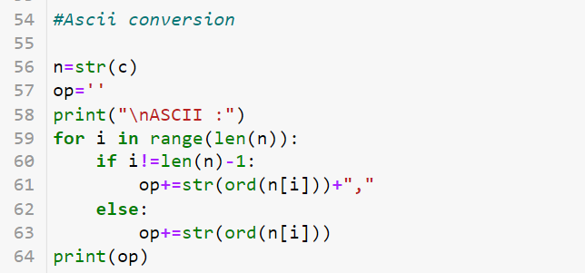
Work Carried Out
ASCII Conversion

Slide 13
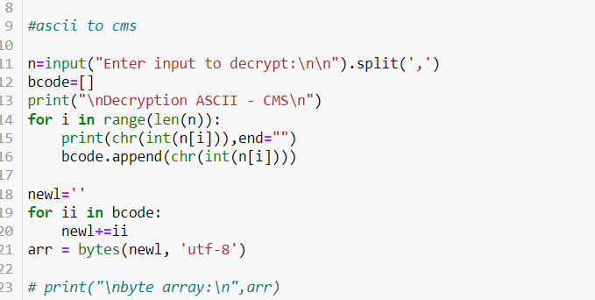
Work Carried Out
ASCII to CMS

Slide 14
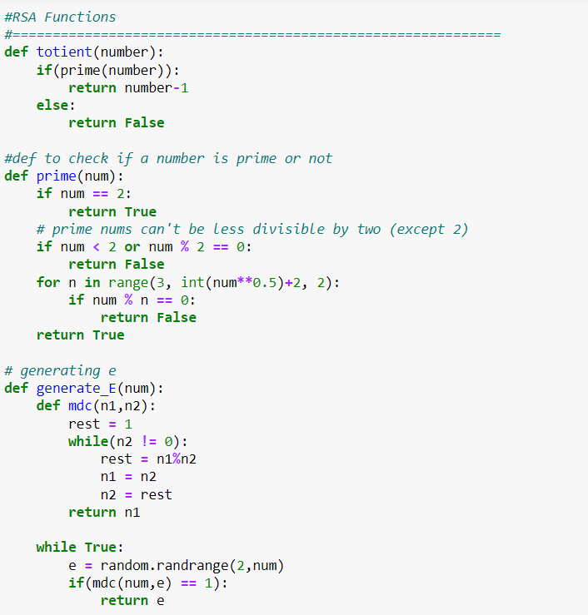
Work Carried Out
CMS to RSA

Slide 15
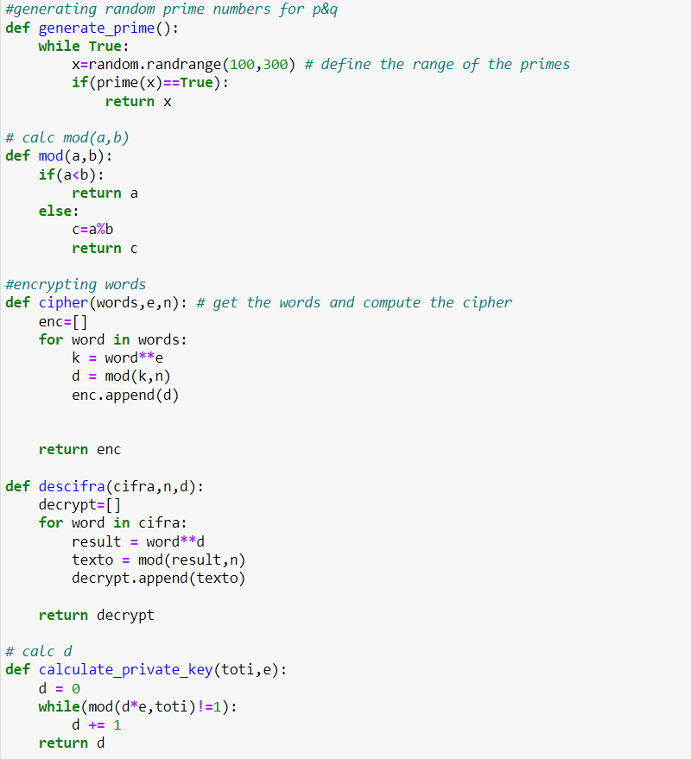
Work Carried Out
CMS to RSA

Slide 16
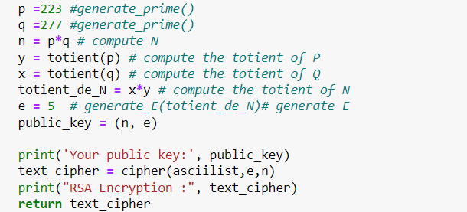
Work Carried Out
CMS to RSA Encryption

Slide 17
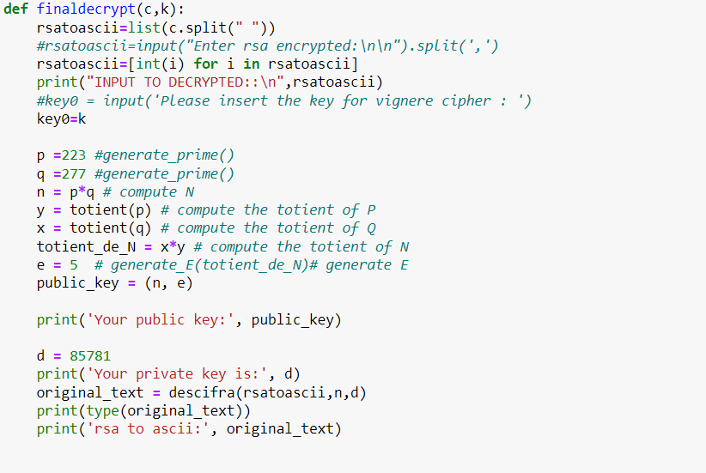
Work Carried Out
CMS to RSA Decryption

Slide 18
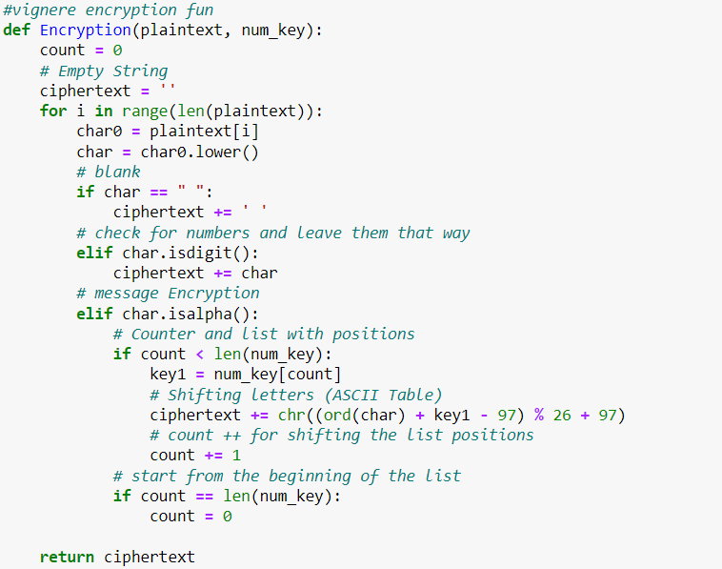
Work Carried Out
Vignere Cipher Encryption

Slide 19
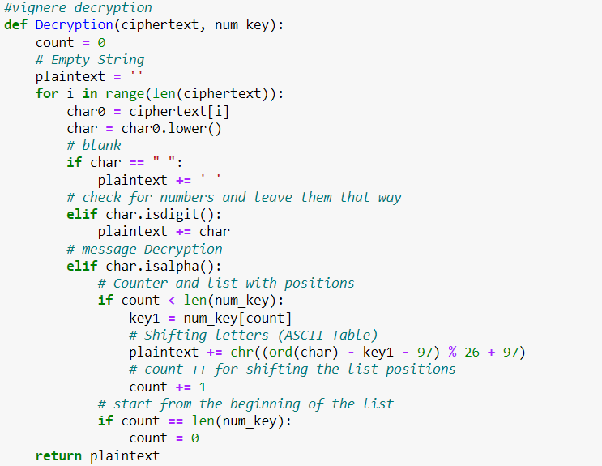
Work Carried Out
Vignere Cipher Decryption

Slide 20
Work Carried Out
Vignere Cipher Encryption

Slide 21
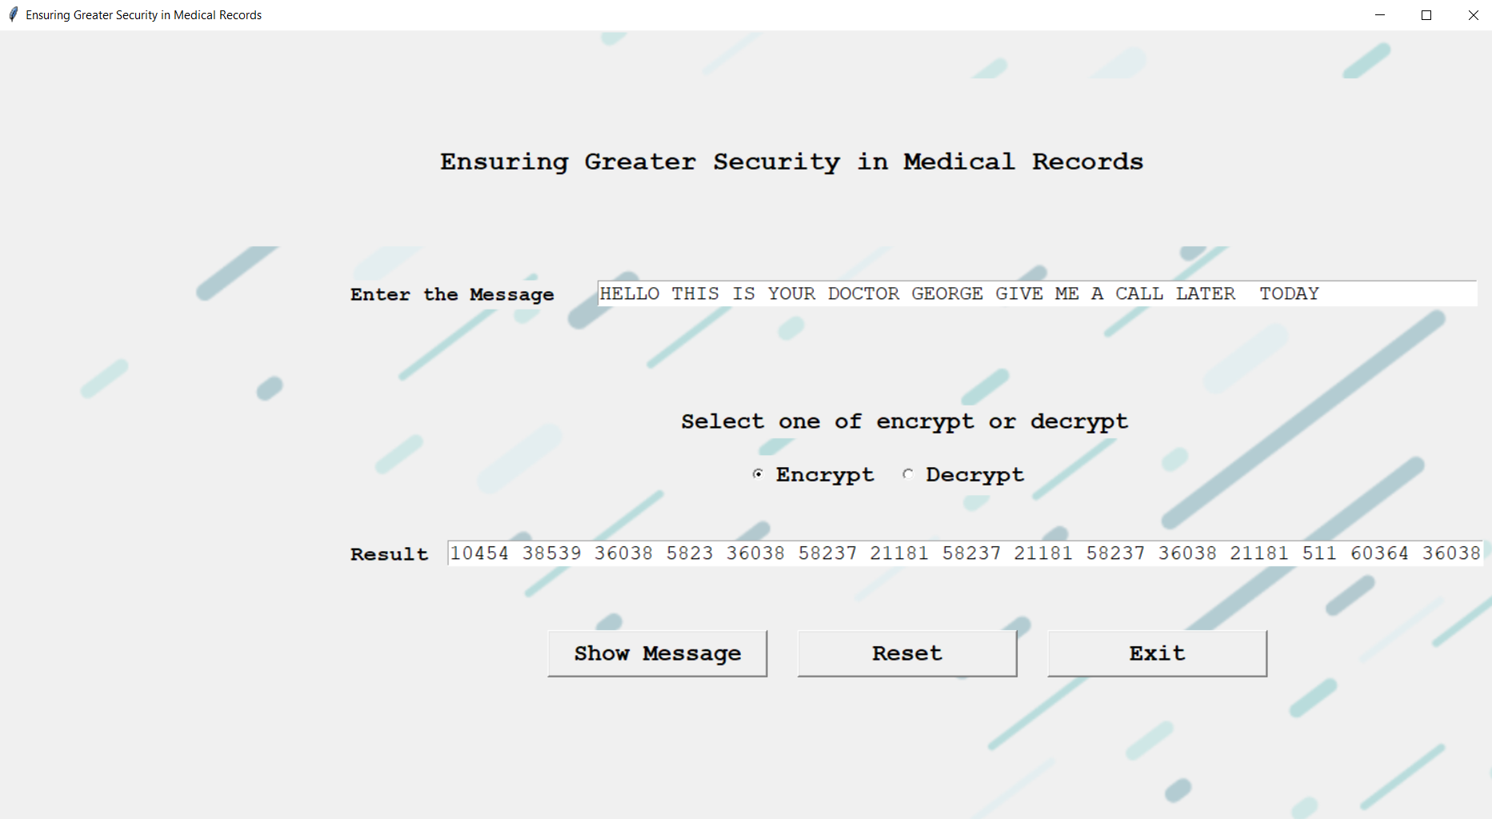
Work Carried Out
Encryption Output for Alpha sequence :

Slide 22
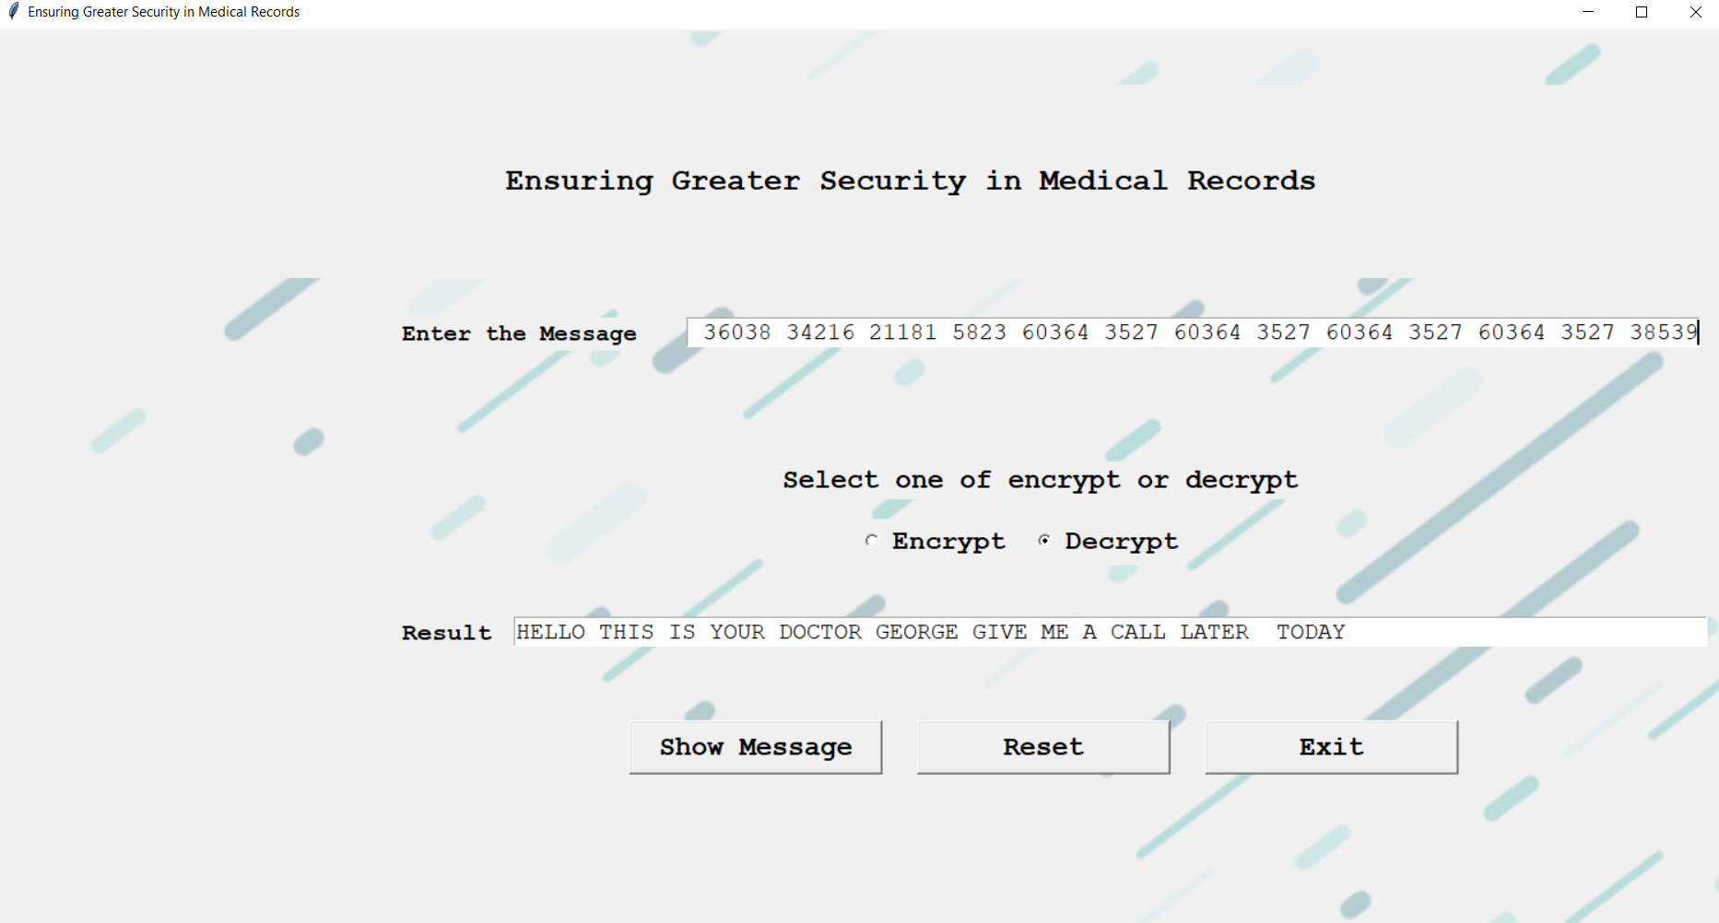
Work Carried Out
Decryption Output Alpha Sequence :

Slide 23
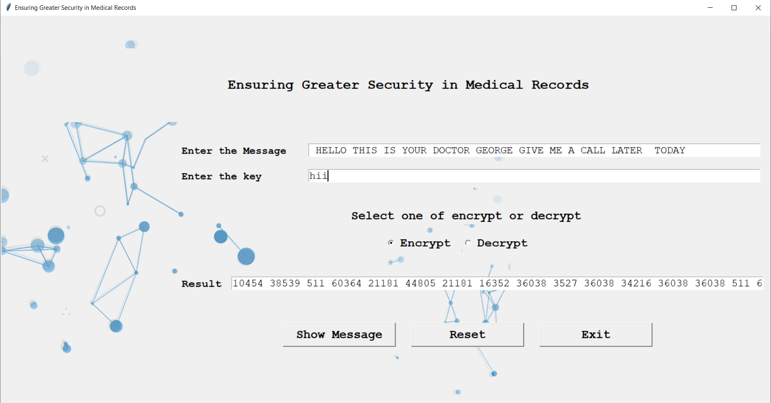
Work Carried Out
Encryption output for Vignere Cipher :

Slide 24
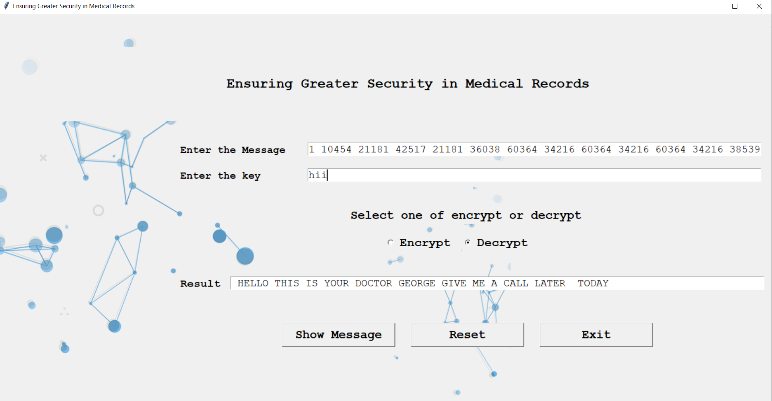
Work Carried Out
Decryption Output for Vignere Cipher :

Slide 25
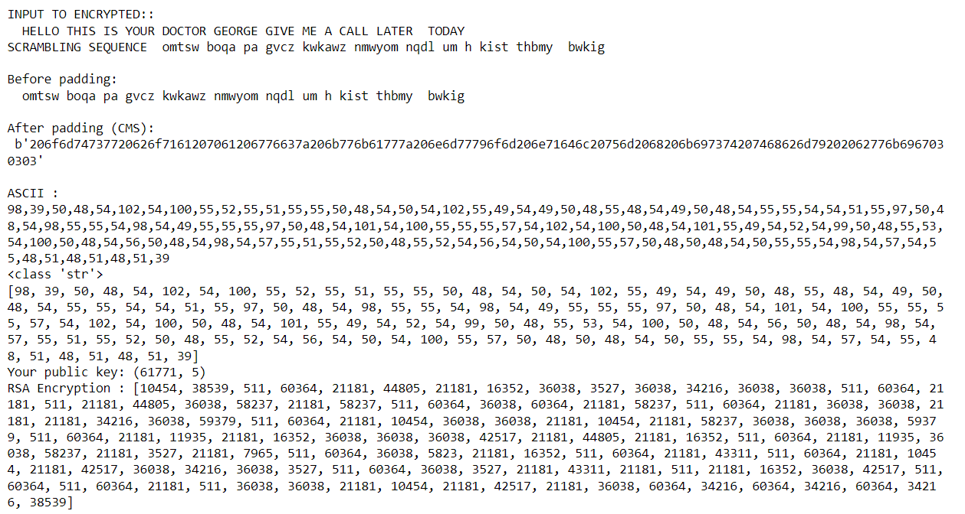
Work Carried Out
Encryption Output for Vignere Cipher :

Slide 26
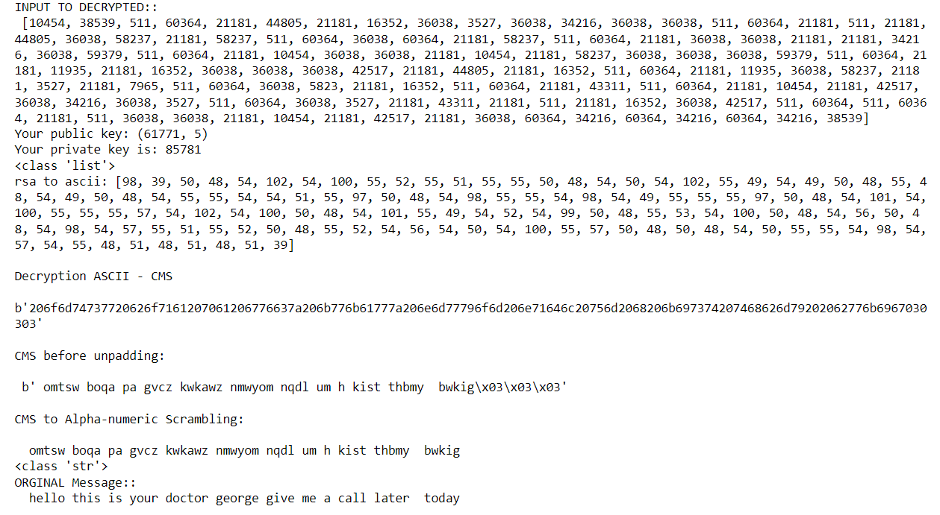
Work Carried Out
Decryption Output for Vignere Cipher :

Slide 27
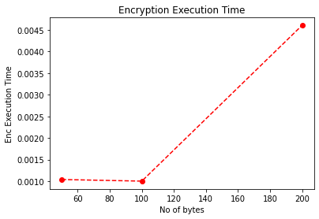
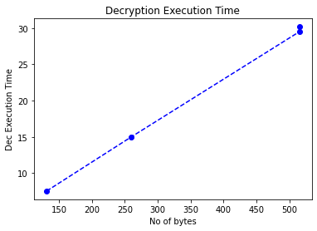
Work Carried Out
Metrics (Time for Alpha sequence)

Slide 28
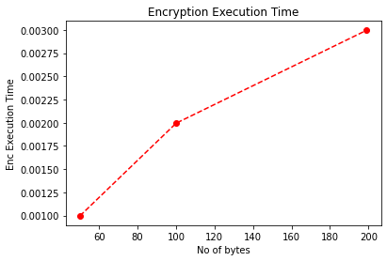
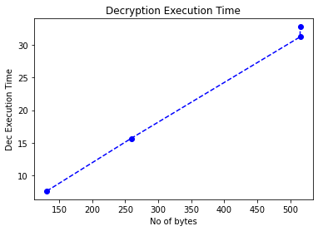
Work Carried Out
Metrics ( Time for Vignere Cipher )

Slide 29
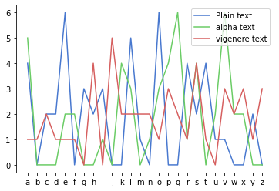
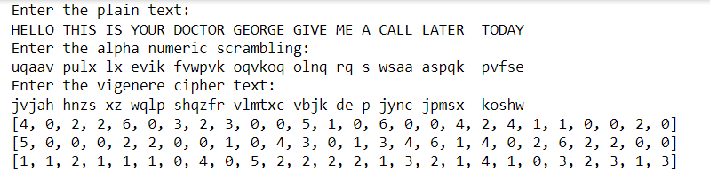
Work Carried Out
Metrics ( statistical attack )

Slide 30
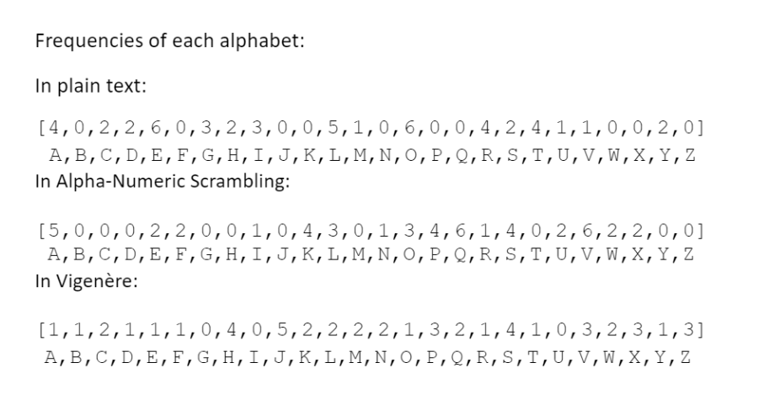
Work Carried Out
Metrics ( statistical attack )

Slide 31
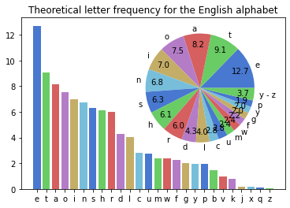
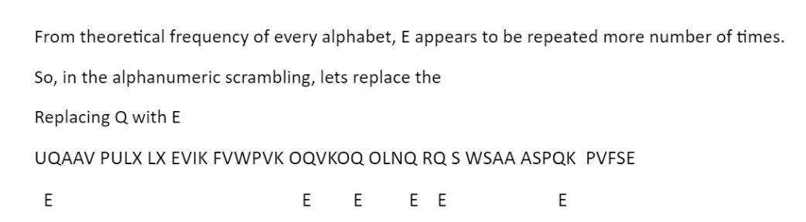
Work Carried Out
Metrics ( statistical attack )

Slide 32
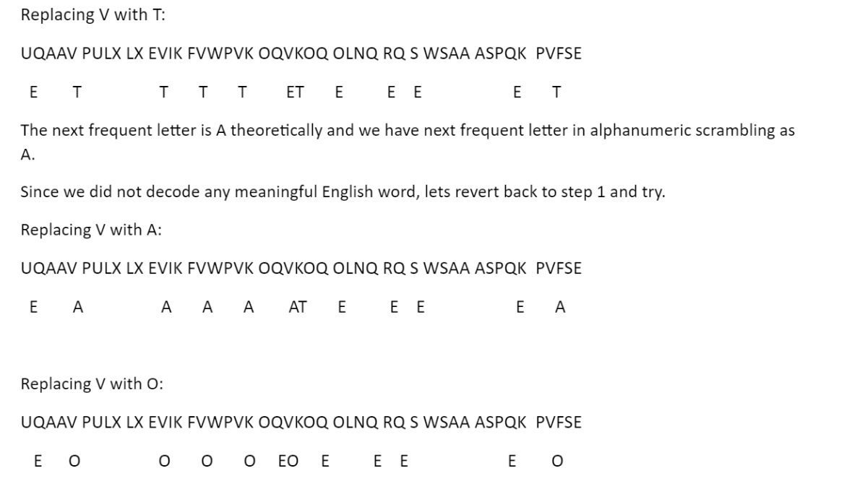
Work Carried Out
Metrics ( statistical attack )

Slide 33
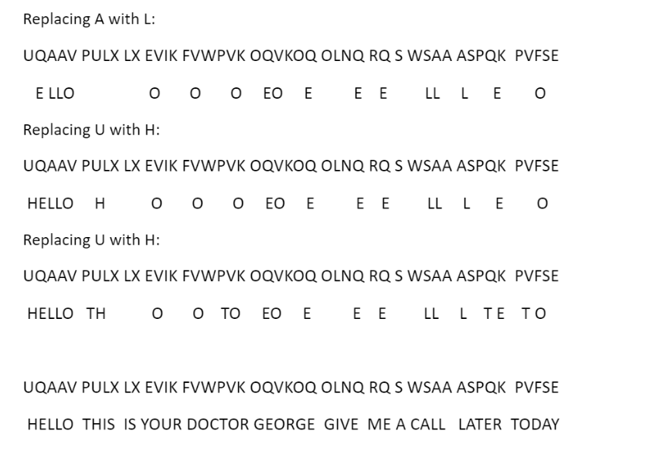
Work Carried Out
Metrics ( statistical attack )

Slide 34
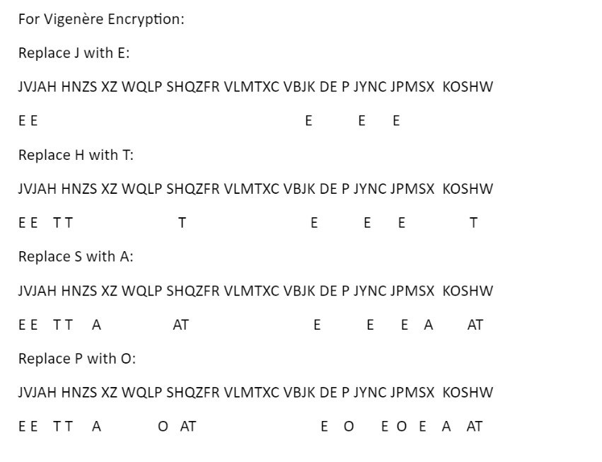
Work Carried Out
Metrics ( statistical attack )

Slide 35
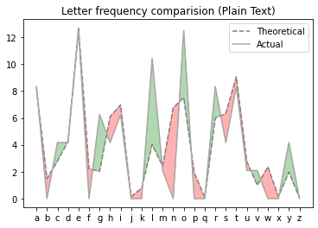
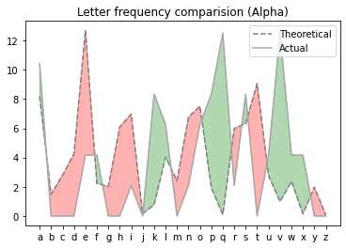
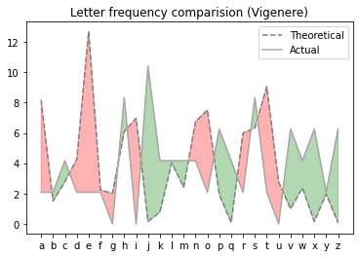
Work Carried Out

Slide 36
Merits and Demerits
Merits:
The Using Polyalphabetic cipher algorithm, Statistical attack can be avoided
By Using Vigenère cipher, it makes more difficult for the attacker to decode the plain text, since Vigenère cipher uses a key to encrypt
Our Proposed model can process the data more than 100kb
The system's vulnerability is minimized
It's simple to use and comprehend
Demerits:
This method ignores the time spent on the encryption and decryption processes.
This technique's calculation might be CPU-intensive.

Slide 37
Conclusion
Conclusion:
We offer a method for ensuring data authenticity and integrity by combining the standard and well-known RSA algorithm with the polyalphabetic cipher randomization approach in this study.
The proposed method is straightforward and simple to comprehend.
It's employed in a system that requires great data security but also requires slower encryption and decryption times.
BytreplacingtalphanumerictscramblingtmethodtwithtVigeneretciphertourtproposedtsystem is resistant to statistical attack

Slide 38
Future Work
Future Plan:
This project can be further extended to show the strength of the algorithm by using enhanced versions of RSA algorithms
Modifying the algorithm to make it suitable for different formats such as images

Slide 39
Implementation
Language used:-
Python

Slide 40
Paper Details
Authors: Victor Chukwudi Osamor , Imuetinyan Boma Edosomwan
Year of publication: 2021
Journal: Informatics in Medicine Unlocked
https://www.sciencedirect.com/science/article/pii/S235291482100157X

Slide 41


